Slide 1
Integrity and Authentication
Module3

Slide 2
Hashing- Introduction
Hashing is a mathematical algorithm that converts plaintext to a unique text string or a ciphertext.
Example
Let’s say your name is Daniel, and you do not want to disclose your name to anyone. With the use of a hashing algorithm, you can represent your name differently in the form of a unique text string. It will only be you who can tell the unique text or number.
Daniel = FO8230hRq5K4g7nA

Slide 3
What is hashing?
A hash value is the output of plaintext or ciphertext.
Hashing is a cryptographic technique that transforms any form of data into a special text string.
For any given input, there is a deterministic output. When you put a plaintext into a hashing algorithm in simpler terms, you get the same outcome. Suppose you change anything about the input or the plaintext to the hashing algorithm. The hashing output also becomes different.

Slide 4
Hashing works by converting a readable text into an unreadable text of secure data.
Hashing is efficiently executed but extremely difficult to reverse.
Hashing and Encryption are often mistaken. Encryption is a two-way function. The plaintext can be encrypted into ciphertext and decrypted back into plaintext using a unique key.
The difference between encryption and hashing is that encryption is reversible while hashing is irreversible.

Slide 5
For example:
In the bank, when you apply for a credit card. You create a password to help you access your account. The bank system does not save your password. The bank system runs the password through a hashing algorithm. It then saves the hash as your password. Every time you attempt to log in to your account. The bank system compares the password you enter with the hash it has saved. Only when the two-match, do you get authorization to access your bank account.

Slide 6
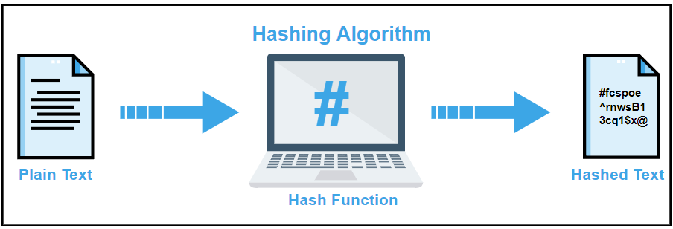

Slide 7
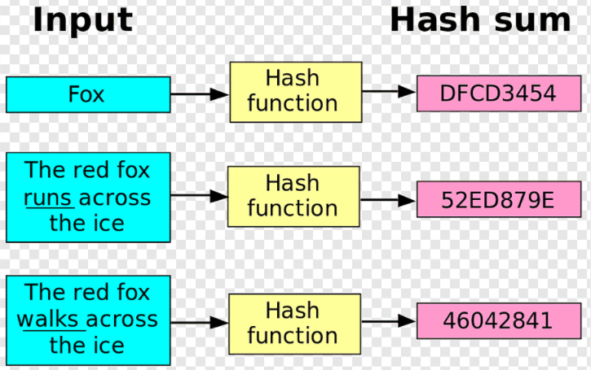

Slide 8
Hashing V.S. Encryption
Hello, world.
A sample sentence to show encryption.
k
E
NhbXBsZSBzZW50ZW5jZSB0byBzaG93IEVuY3J5cHRpb24KsZSBzZ
Hello, world.
A sample sentence to show encryption.
D
k
NhbXBsZSBzZW50ZW5jZSB0byBzaG93IEVuY3J5cHRpb24KsZSBzZ
Encryption is two way, and requires a key to encrypt/decrypt
This is a clear text that can easily read without using the key. The sentence is longer than the text above.
h
52f21cf7c7034a20 17a21e17e061a863
Hashing is one-way. There is no 'de-hashing’

Slide 9
A hash function H accepts a variable-length block of data M as input and produces a fixed-size hash value h = H(M).
A "good" hash function has the property that the results of applying the function to a large set of inputs will produce outputs that are evenly distributed, and apparently random.
In general terms, the principal object of a hash function is data integrity. A change to any bit or bits in M results, with high probability, in a change to the hash code.

Slide 10
Cryptographic hash function
The kind of hash function needed for security applications is referred to as a cryptographic hash function.
A cryptographic hash function is an algorithm for which it is computationally infeasible (because no attack is significantly more efficient than brute force) to find either
a data object that maps to a pre-specified hash result (the one-way property) or
two data objects that map to the same hash result (the collision-free property).
Because of these characteristics, hash functions are often used to determine whether or not data has changed

Slide 11
Hash Function Applications
Message Authentication
Digital Signatures
One way Password File
Intrusion Detection and Prevention

Slide 12
Message Authentication
Message authentication is a mechanism or service used to verify the integrity of a message.
Message Authentication assures that data received are exactly as sent without any modification.
When a hash function is used for message authentication, that hash function value is referred as message digest.

Slide 13
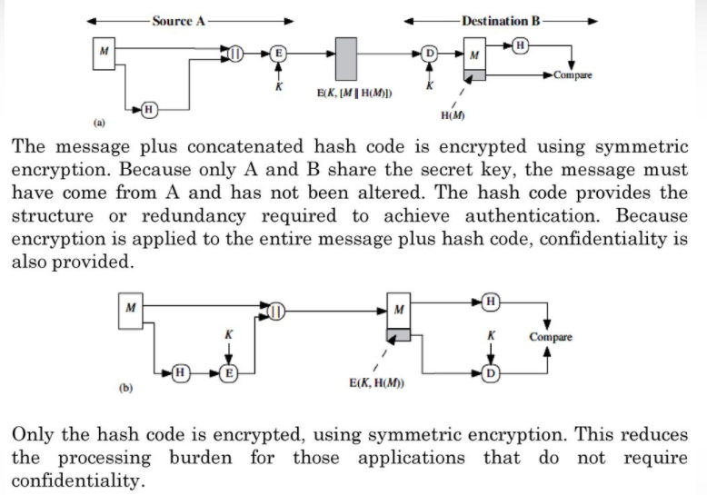

Slide 14
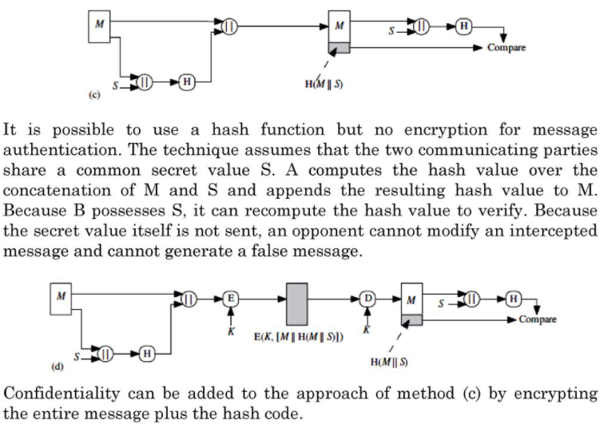

Slide 15
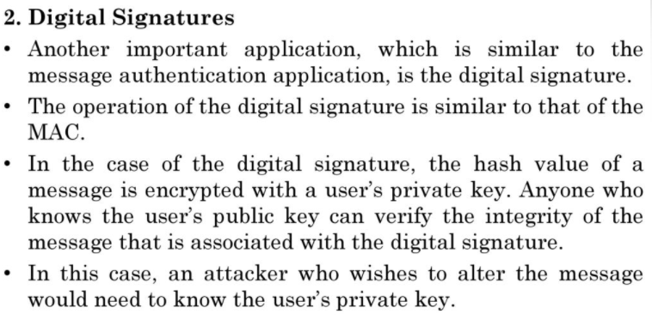

Slide 16
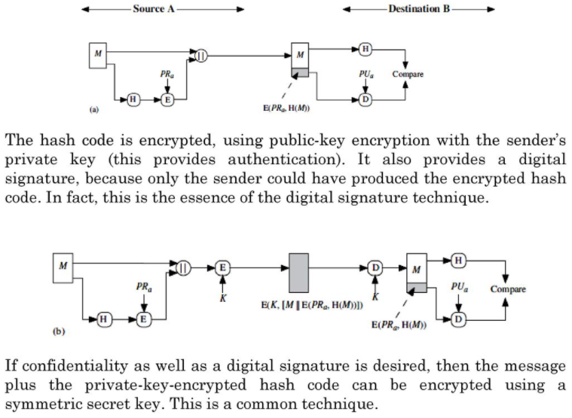

Slide 17
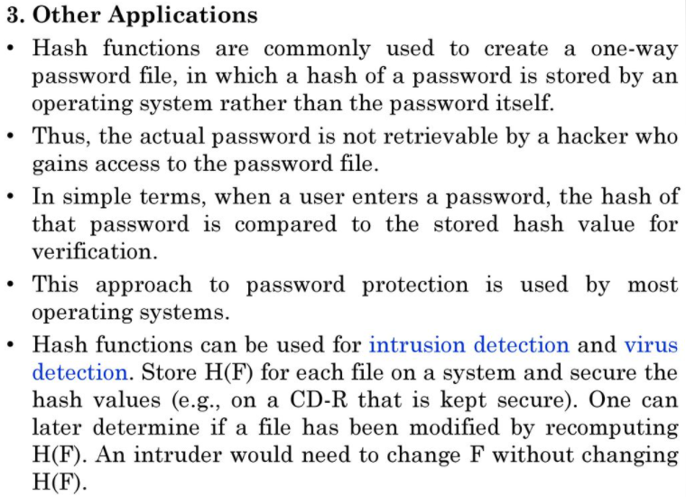

Slide 18
Password Verification
Store Hashing Password
Verification an input password against the stored hash
Iam#4VKU
Iam#4VKU
Password store
h
h
661dce0da2bcb2d8 2884e0162acf8194
661dce0da2bcb2d8 2884e0162acf8194
661dce0da2bcb2d8 2884e0162acf8194
Hash Matching Exactly?
Password store
Yes
No
Grant
Deny

Slide 19
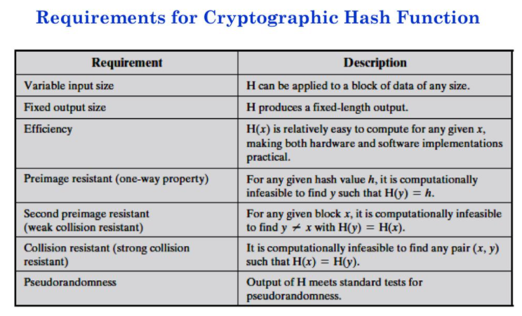

Slide 20
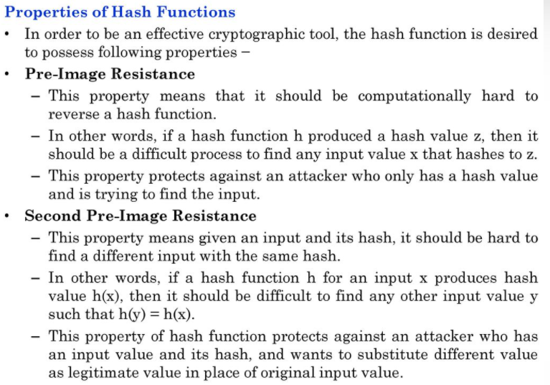

Slide 21
